Slide 1
2020 Georgia State Elections
Primary Outcomes, General Elections and Potential Impact

Slide 2
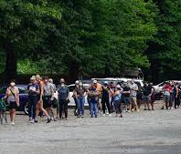
Primary Election Analysis: Unique Factors
Candidate Issues
Incumbent Disadvantage
Voter Psyche
Legislator Fatigue
Voting Issues
Absentee Ballot Delays
11,000 voters
New Machines
Poll Workers
Impact of COVID on In-Person Voting

Slide 3
Primary Election Analysis: Voter Turn Out

Slide 4
Primary Election Analysis-Impact
Races Decided
111 with 125 in Play
26 Open
Incumbent Losses
Rep. Pam Dickerson (D-Conyers)
Rep. Jeff Jones (R-Brunswick)
Constitutional Officers
Leadership Concerns/Opportunity

Slide 5
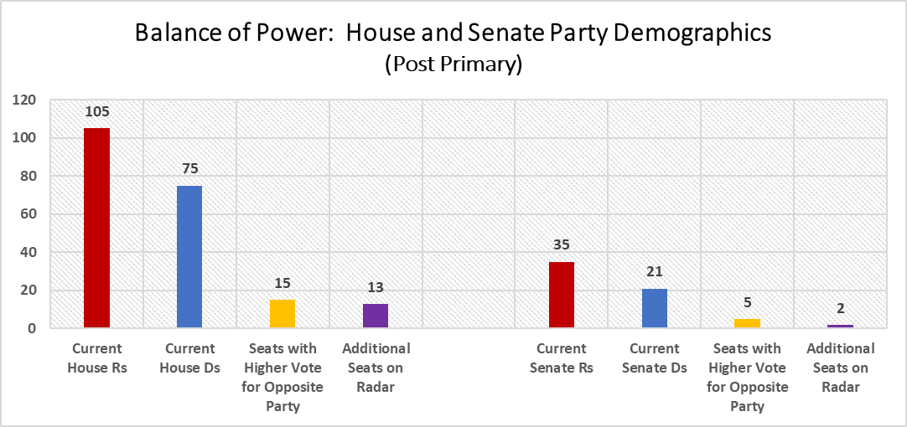
2020 General Election: Balance of Power

Slide 6
General Election: Components in Outcome
Presidential Election
Democrat Organization
GOP Messaging
Redistricting
Fatigue
COVID
Voter Psyche

Slide 7
General Election: Potential Impact to Credit Unions
Key Seats at Risk
Sen. PK Martin (R-Lawrenceville)
Rep. Brett Harrell (R-Snellville)
Rep. Bob Trammell (D-Luthersville)
Open Seat in Play
Max Burns (R-Sylvania)
Impact of House Leadership
Reversal of Power?
Balance of Power?

