Slide 1
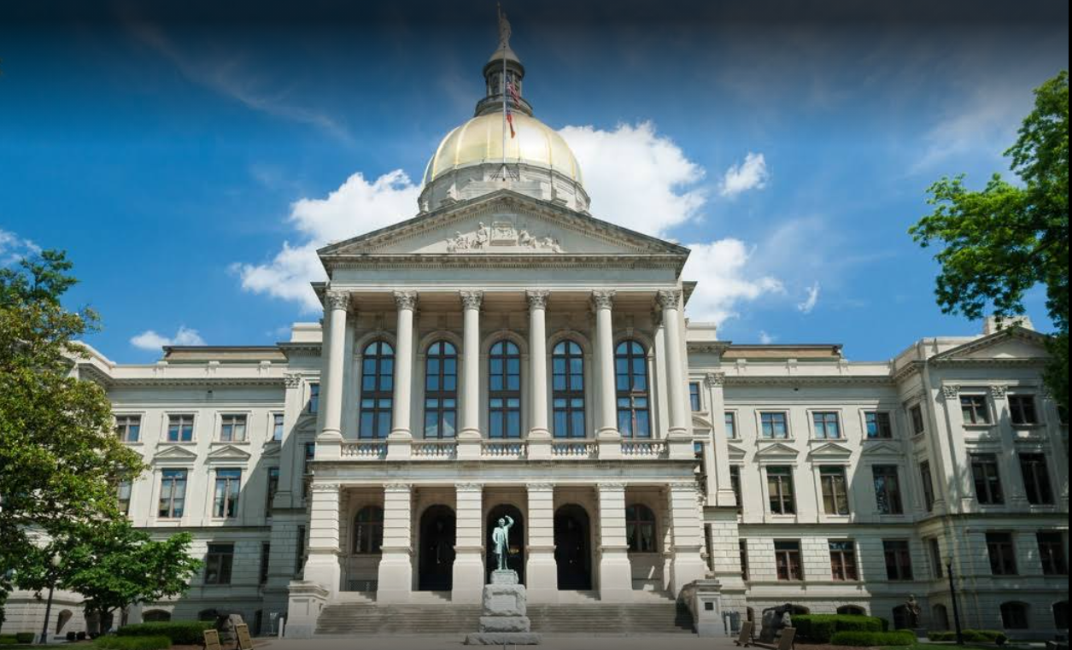


Update from the Gold Dome
GCUEA Spring Meeting
Tuesday, March 15, 2022
Omni Hilton Head Oceanfront Resort

Slide 2
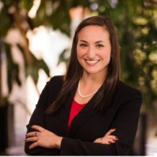
Update from the Gold Dome
Sydney Rubin Seral
Vice President of Advocacy
League of Southeastern Credit Unions & Affiliates
Georgia Credit Union Association

Slide 3
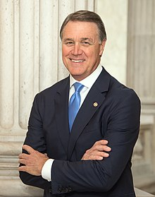
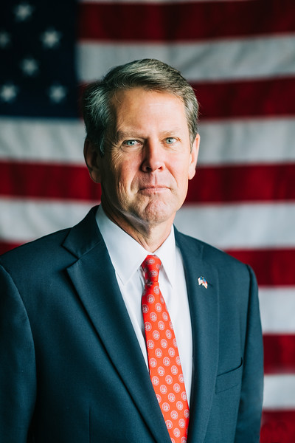
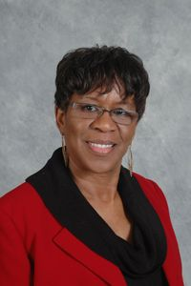
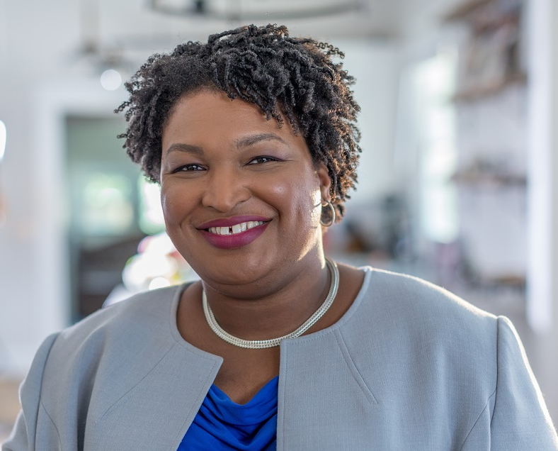
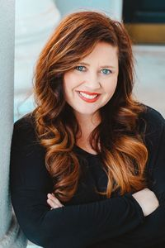
Race to the Governor’s Mansion
Catherine Davis (R)
Non-profit president
Former Senator
David Perdue (R)
Stacey Abrams (D)
Former State Minority Leader; Founder of Fair Fight Action
Incumbent Governor
Brian Kemp (R)
Kandiss Taylor (R)
Educator

Slide 4
Race to the Governor’s Mansion

Slide 5
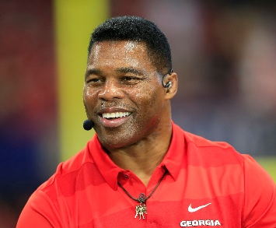
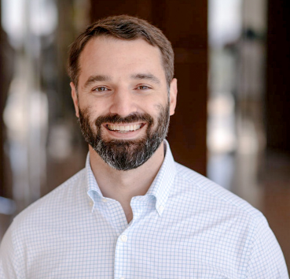
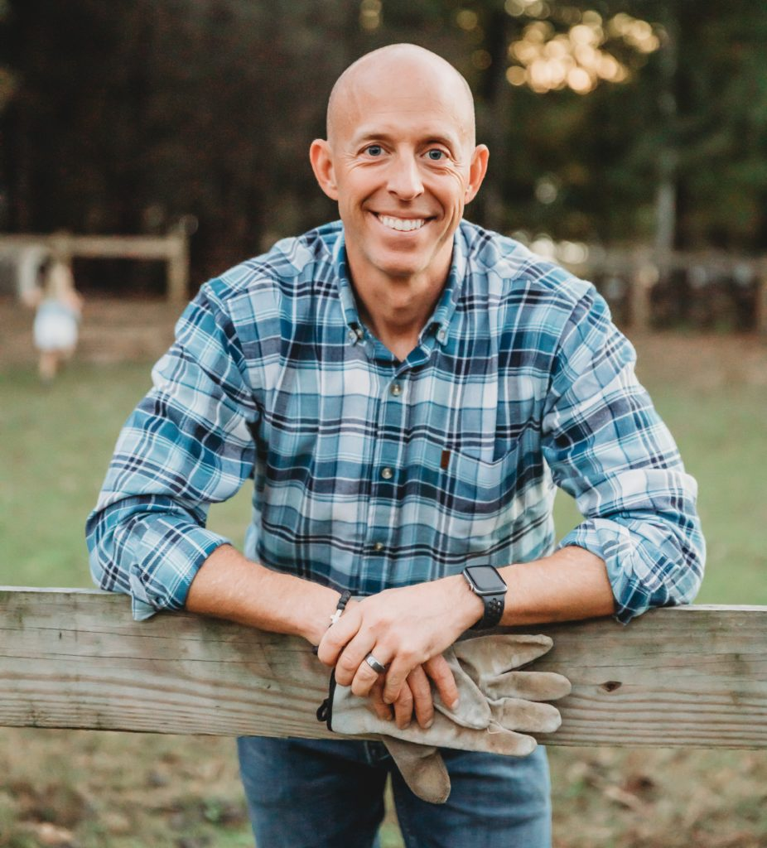
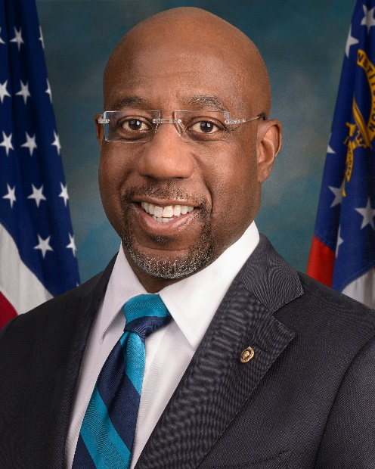
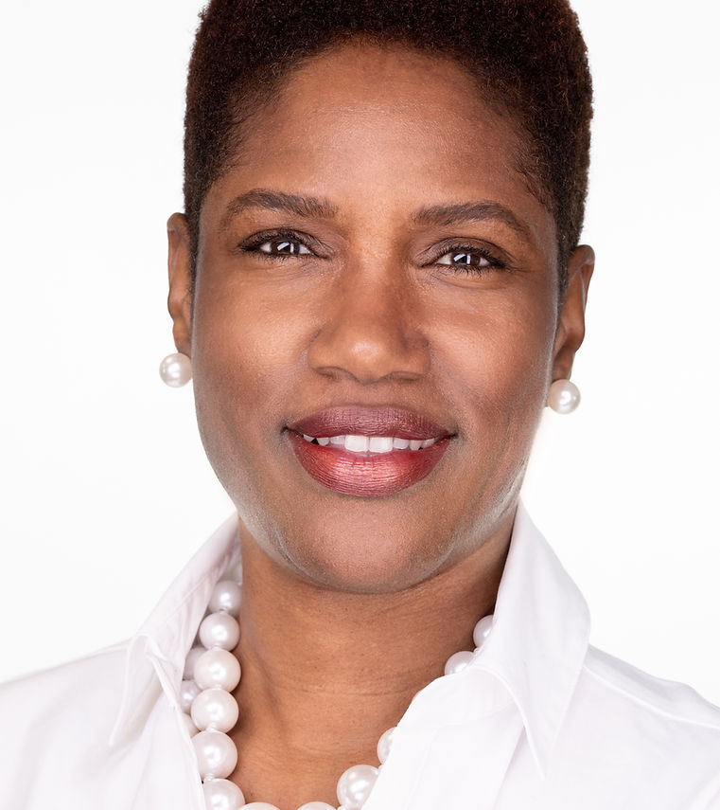
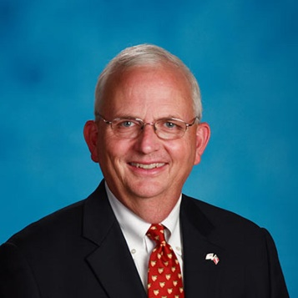
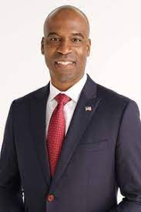
U.S. Senate Race
Herschel Walker (R)
Former Professional & UGA football player, All-American, and Heisman winner
Latham Saddler (R)
Former Navy SEAL officer and Director of Intelligence Programs on the National Security Council
Josh Clark (R)
Executive at NeoLife North America and former State Rep.
Tamara Johnson-Shealey (D)
Founded two beauty and barber industry professional organizations
Gary Black (R)
Georgia Agriculture Commissioner since 2011
Kelvin King (R)
Former US Air Force veteran and current construction executive
Incumbent
Raphael Warnock (D)

Slide 6
U.S. Senate Race

Slide 7
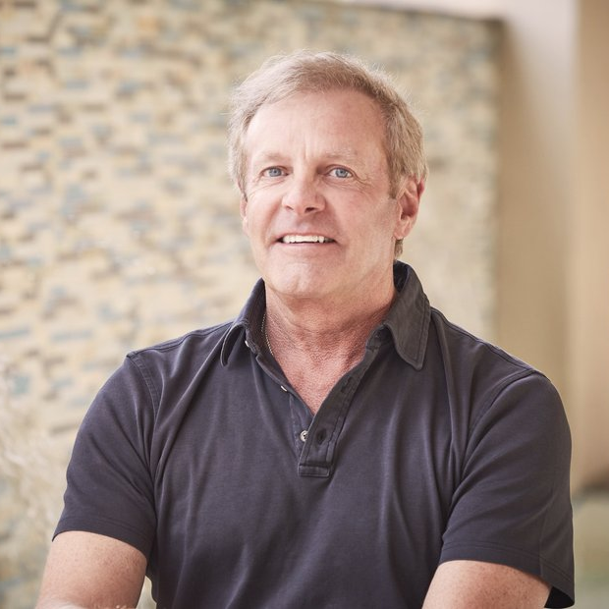
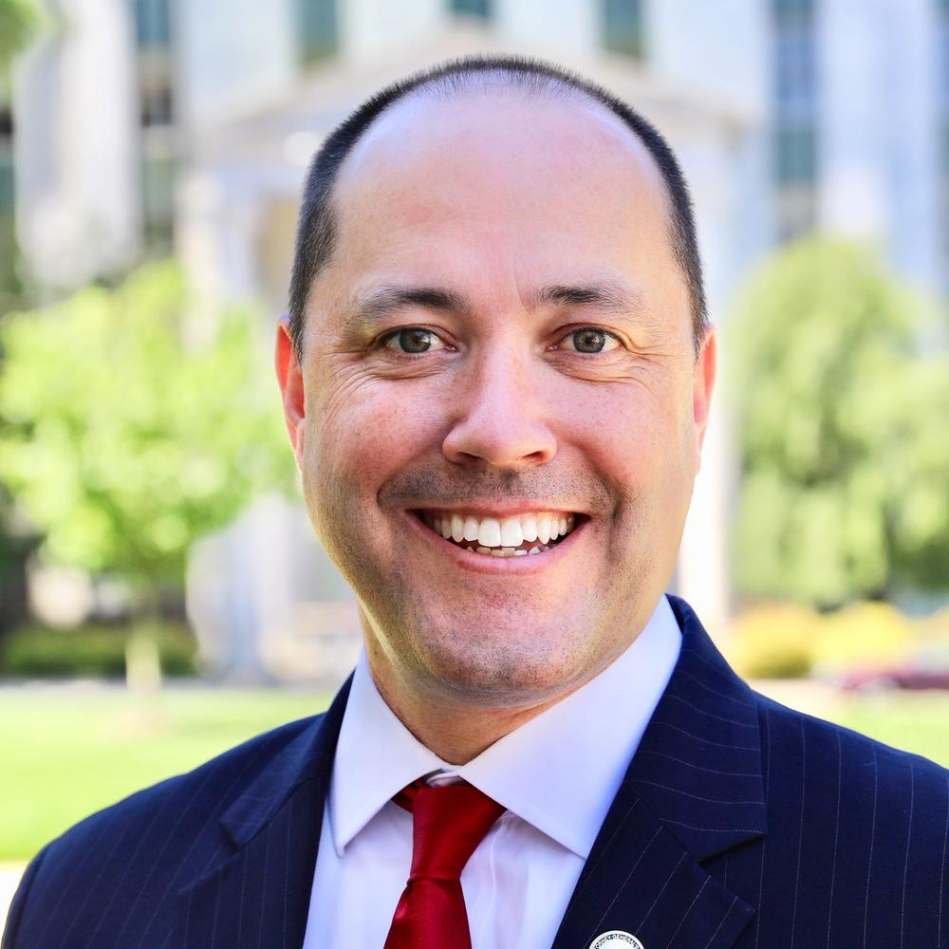
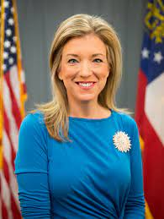
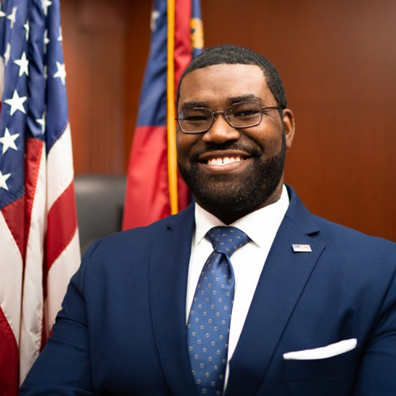
Attorney General
John Gordon (R)
Conservative lawyer
Incumbent Attorney General Chris Carr (R)
State Senator
Jen Jordan (D)
Christian Wise Smith (D)
Assistant District Attorney

Slide 8
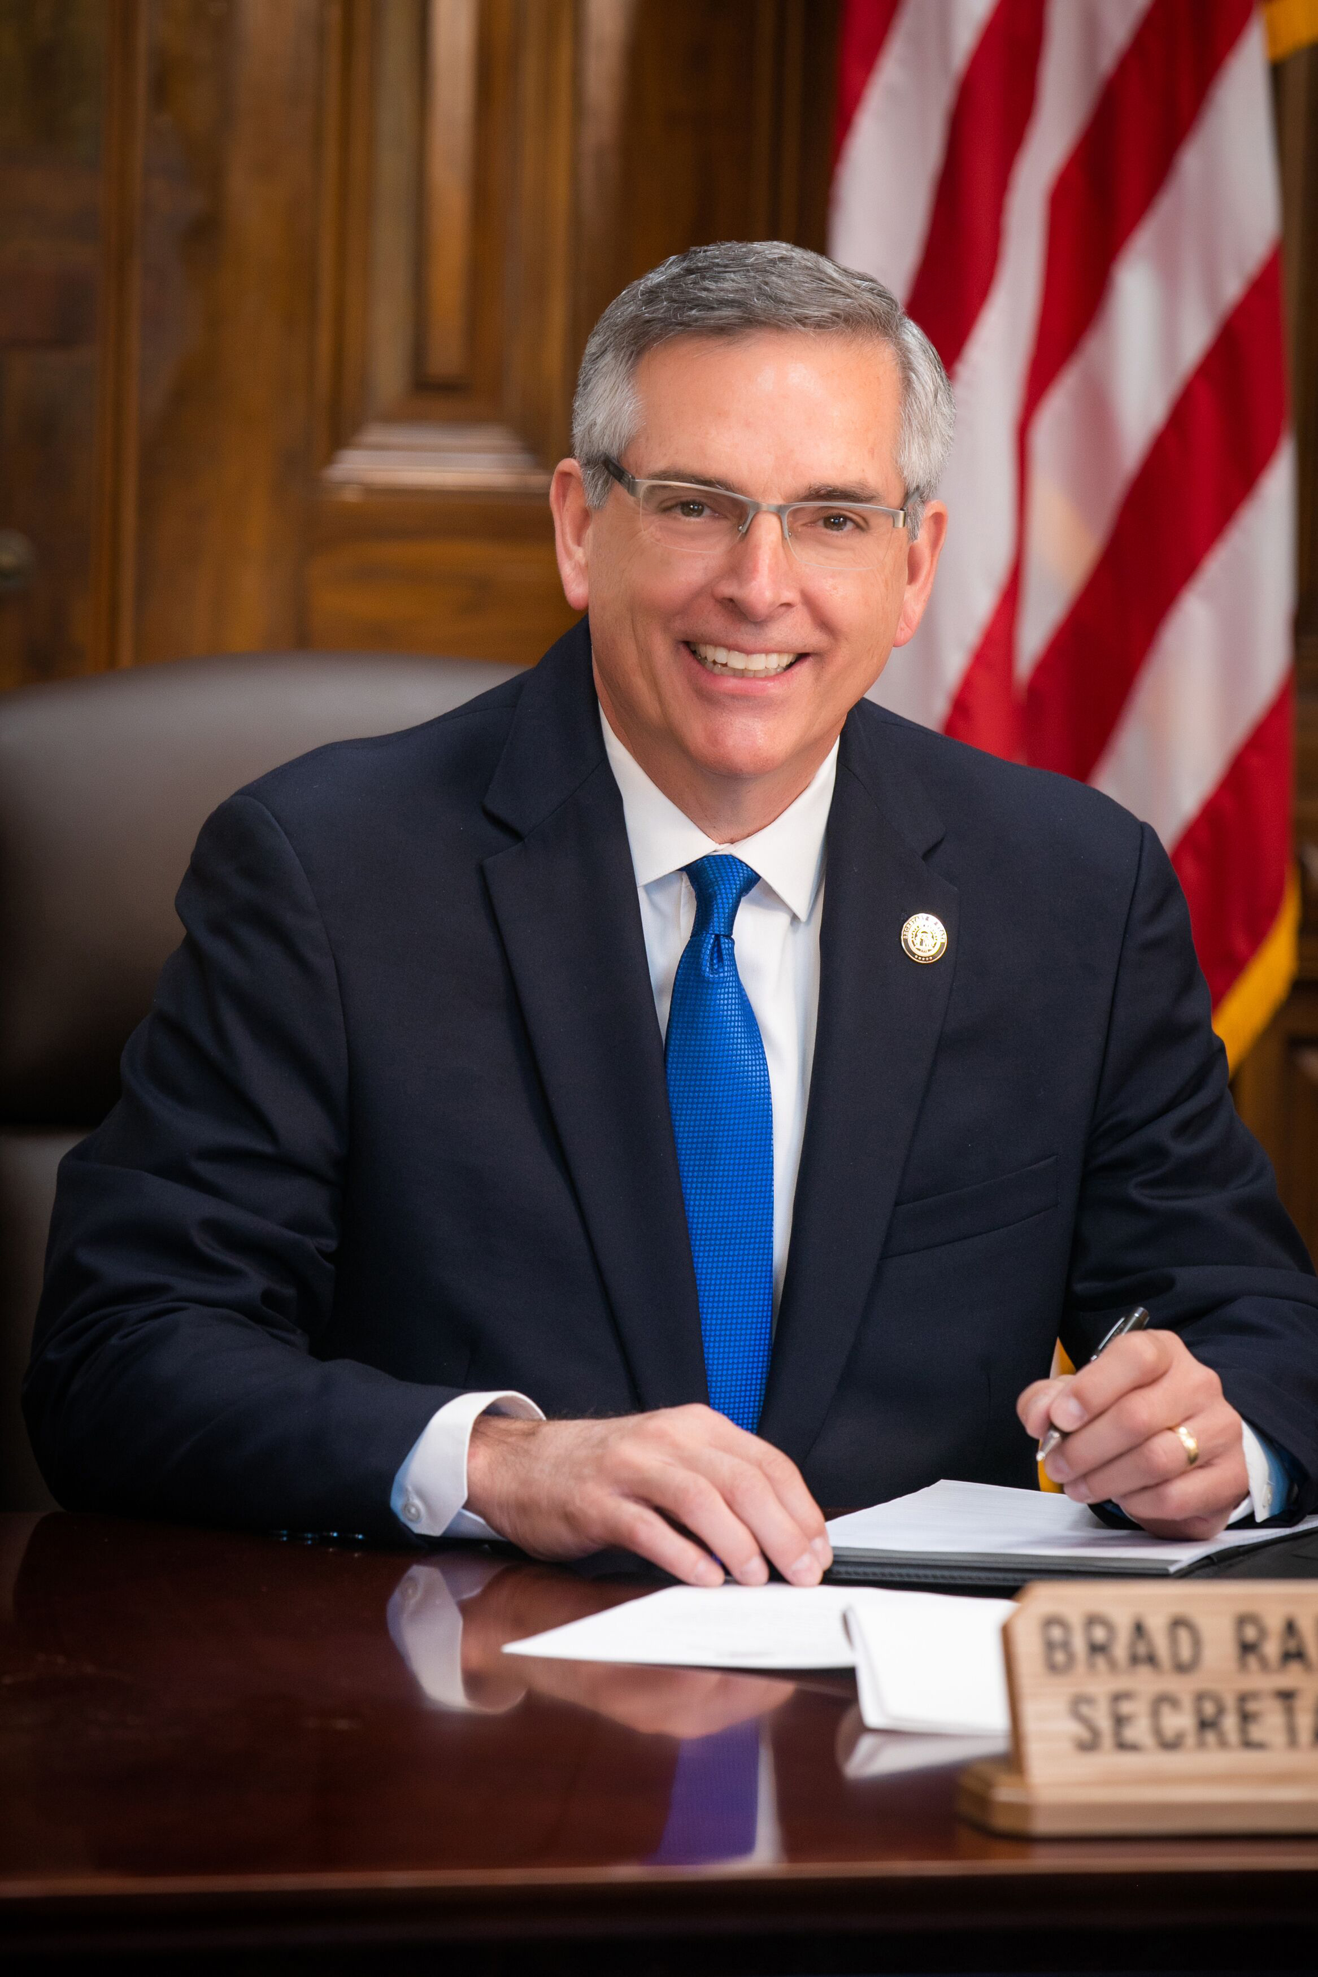

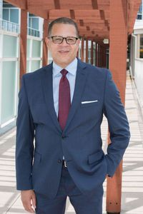
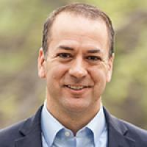
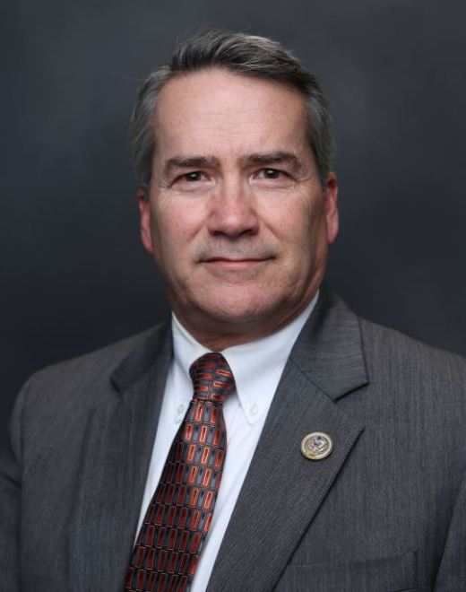
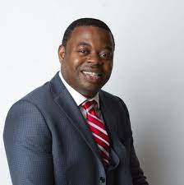
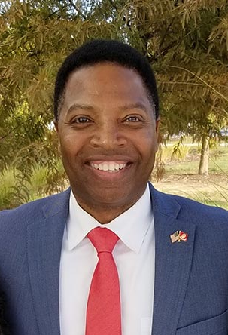
Secretary of State
David Belle Isle (R)
Former Mayor of Alpharetta
Congressman Jody Hice (R)
John Eaves (D)
Former Fulton County Board of Commissioners Chairman
State Rep. Bee Nguyen (D)
District 89
T.J. Hudson (R)
Former Judge of Treutlen Magistrate Court
Incumbent Secretary of State
Brad Raffensperger (R)
Michael Owens (D)
Cyber Security Expert

Slide 9
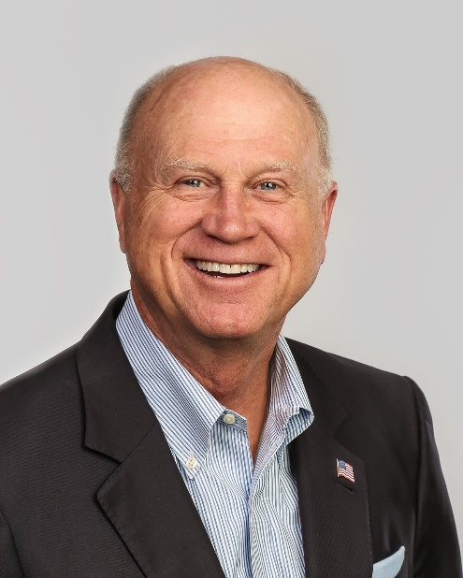
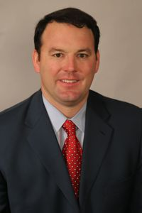
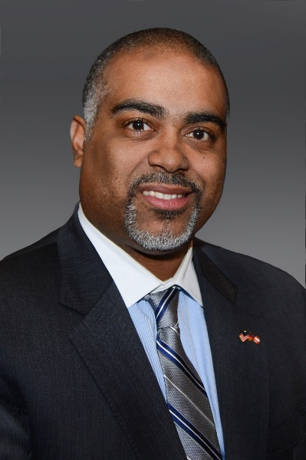
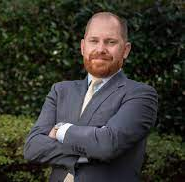
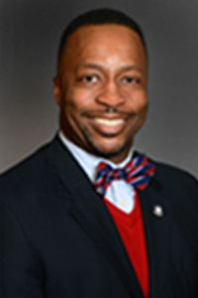
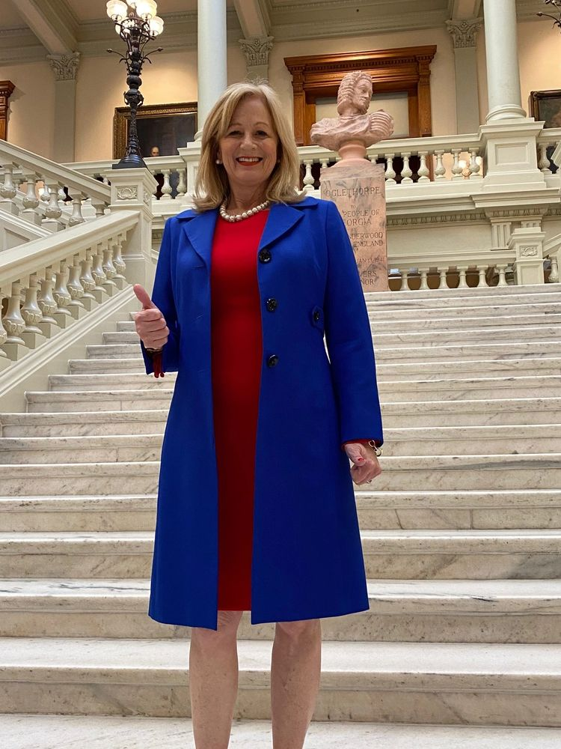

Lieutenant Gubernatorial Race
Butch Miller
(R-GA-49)
Senate President
Pro Tempore
Gainesville
Burt Jones
(R-GA-25)
State Senator
Jackson
Charlie Bailey (D)
Former Candidate for Attorney General
Erick Allen
(D-GA-40)
State Representative
Smyrna
Derrick Jackson
(D-GA-64)
State Representative
Tyrone
Jeanne Seaver (R)
Businesswoman and activist
Renitta Shannon
(D-GA-40)
State Representative
Decatur

Slide 10
U.S. House of Representatives Snapshot
U.S. Congress
District | Member of Congress | Primary Opponent | General Opponent
1 | Buddy Carter | No | Yes
2 | Sanford Bishop* | Yes | Yes
3 | Drew Ferguson* | Yes | Yes
4 | Hank Johnson | No | Yes
5 | Nikema Williams* | Yes | Yes
6 | OPEN – Rich McCormick*
7 | Carolyn Bourdeaux | Yes | Yes
8 | Austin Scott | No | Yes
9 | Andrew Clyde | Yes | Yes
10 | OPEN – Mike Collins*
11 | Barry Loudermilk* | No | Yes
12 | Rick Allen | No | Yes
13 | David Scott* | Yes | Yes
14 | Marjorie Taylor Greene | Yes | Yes

Slide 11
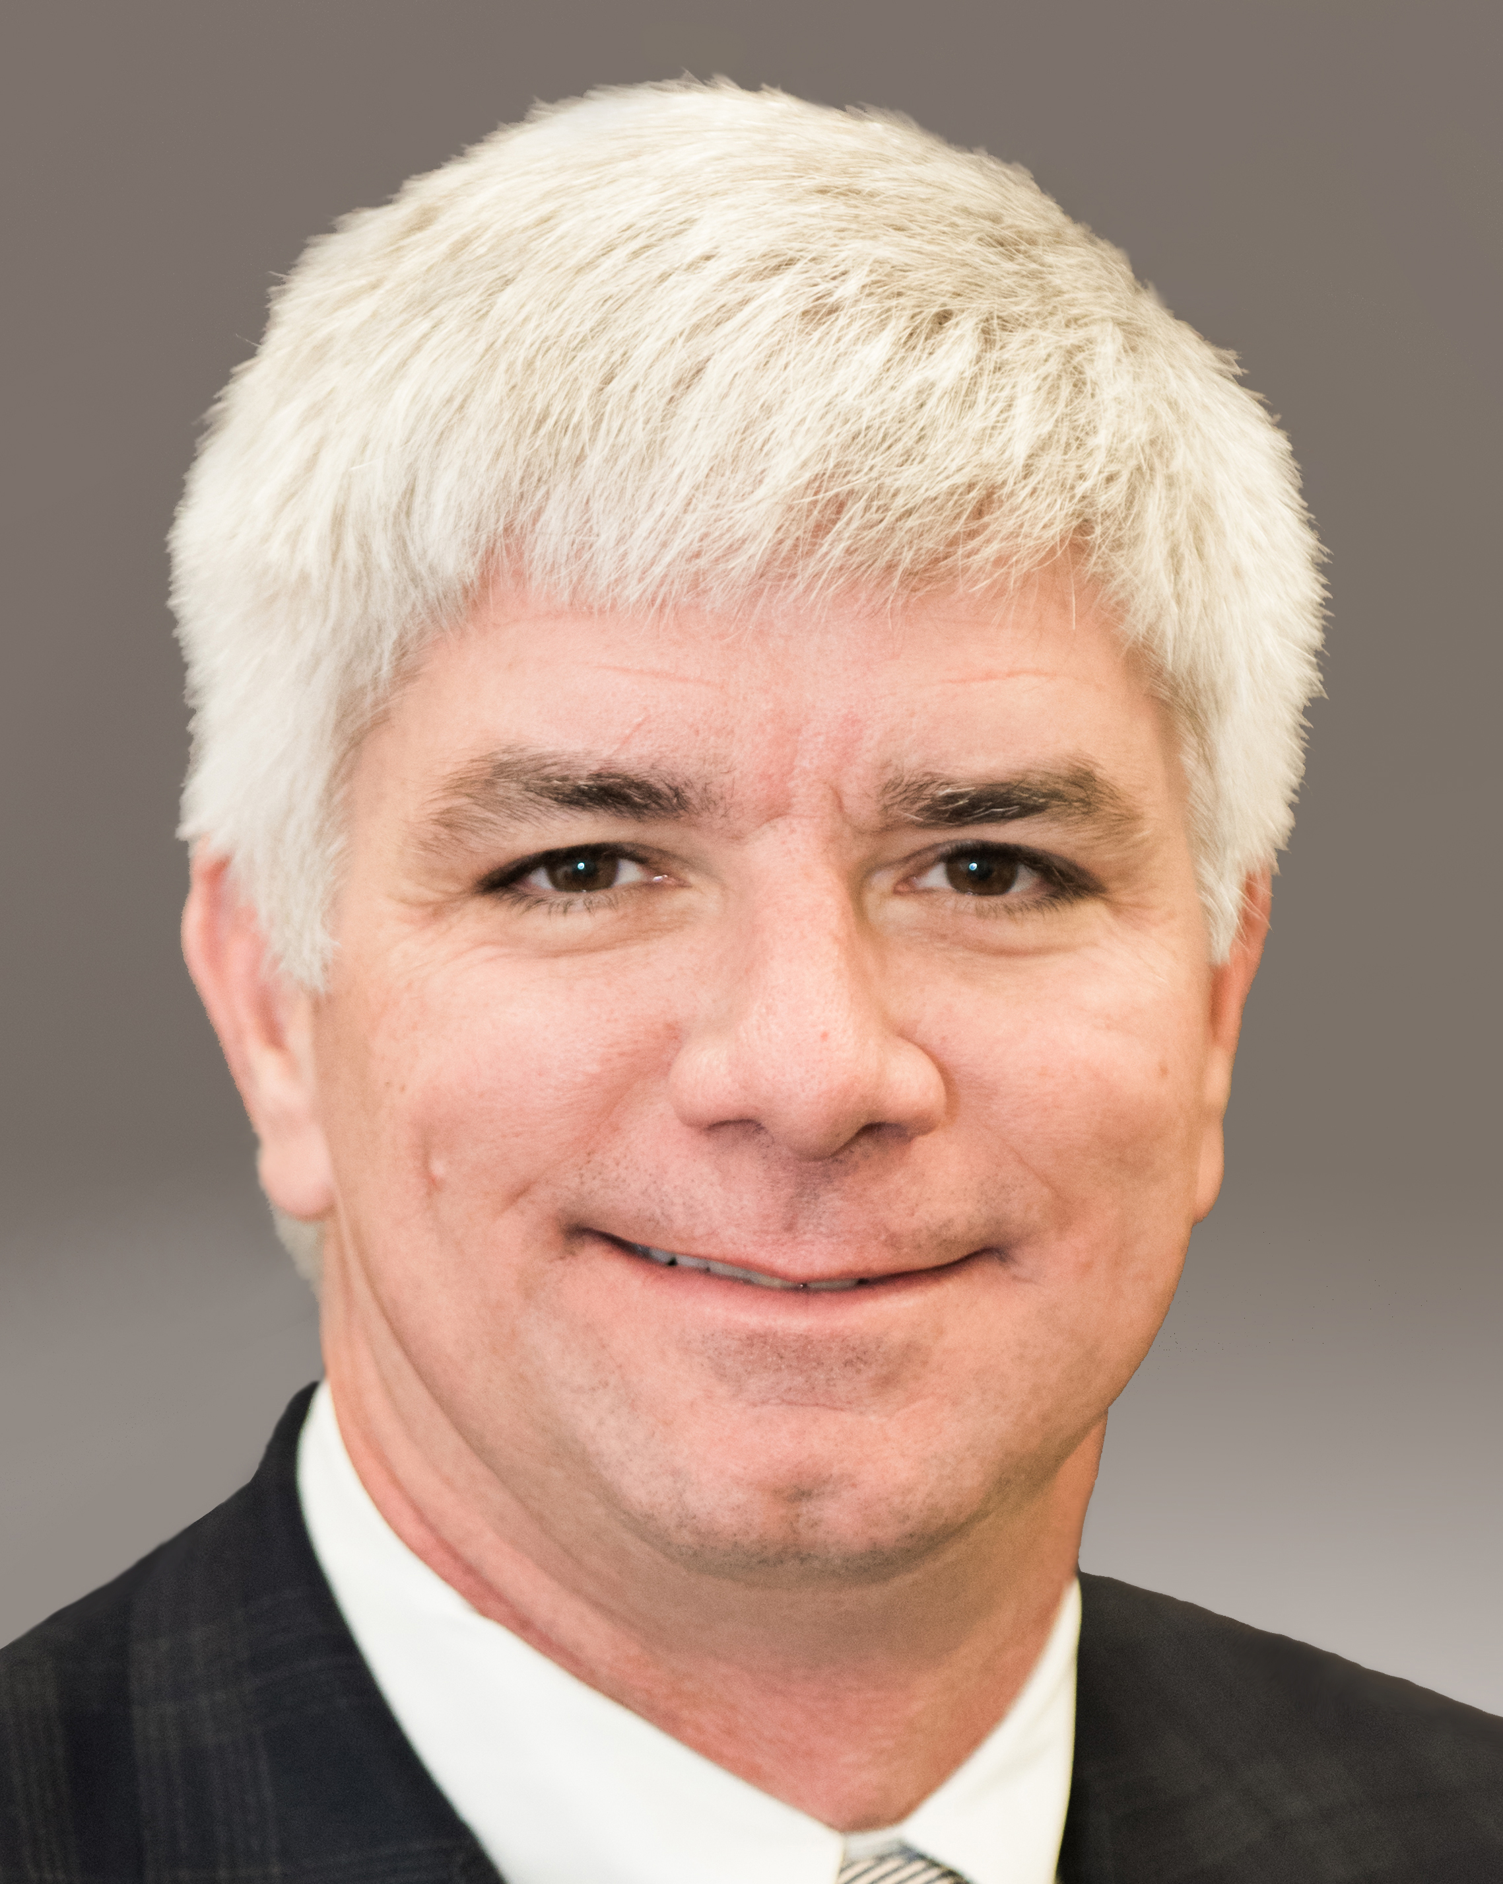
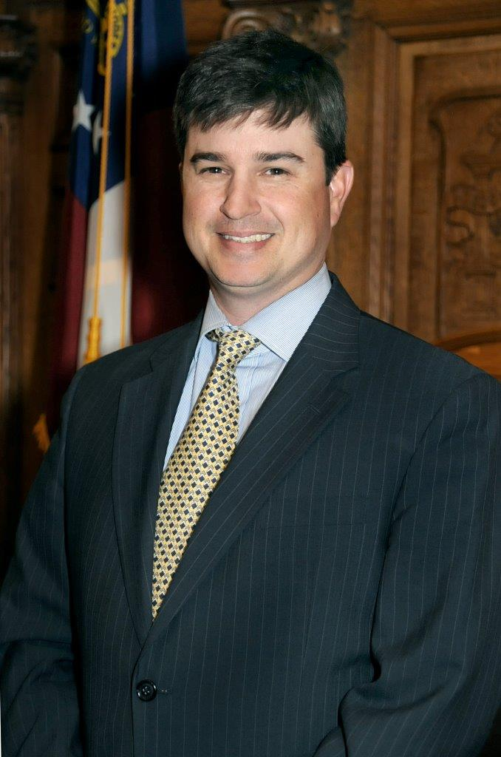
2022 State Legislature: Environment, People and Issues Important to Credit Unions
House Banks & Banking Committee
Chairman Noel Williams (R)
District 148, Cordele
Senate Banking & Financial Institutions
Committee
Chairman Matt Brass (R)
District 28, Newnan

Slide 12
2022 State Legislature: Environment, People and Issues Important to Credit Unions
Electronic & Remote Online Notarization (RON)
HB 334 - RON would allow credit unions to reduce turnaround times and improve operational efficiencies, while serving your members with a digital-first member experience.
RON improves access to notary services and thus financial services in underserved and unbanked communities.
Governor Kemp signed an Executive Order in response to the Public Health State of Emergency that permits Remote Notarization in 2020, and that is still active.
GCUA is working diligently to advocate for legislation that implements electronic and remote online notarization permanently in the state of Georgia.
House conference committee has been appointed: Rep. Joseph Gullett (R-Dallas), Judiciary Chairman Chuck Efstration (R-Dacula), Judiciary Vice Chairman Stan Gunter (R-Blairsville).

Slide 13
2022 State Legislature: Environment, People and Issues Important to Credit Unions
Promoting Financial Literacy
Beginning financial education early in life is a key to long-term financial health. Georgia requires financial education courses in high school to be offered and that one or more of these courses are taken. While Georgia continues to get high marks for its financial education in high schools, there is still room for improvement.
The GCUA is supportive of all initiatives to further financial literacy.
SB 220 by Senator Chuck Payne/Rep. Gambill requires the State Board of Education to prescribe a personal financial literacy program to be completed during high school, including money management, balancing a checking account, computing federal income taxes, and state/federal laws concerning finance and cryptocurrency.
The State Board of Education approved revised standards to the high school economics course in December of 2021 to significantly expand the amount of personal finance instruction within the existing economics course. The bill sponsor currently feels that is a good compromise.

Slide 14
2022 State Legislature: Environment, People and Issues Important to Credit Unions
State Charter Enhancements
Over the past several years, the GCUA has worked with credit unions in conjunction with the Department of Banking & Finance to enhance the state charter. While some improvements have been made, it is important to continue to look at ways to enhance the state charter.
The GCUA is actively working to support HB 891 and HB 899, legislation encompassing the DBF’s Annual Housekeeping Legislative Package.
HB 891 – Streamlines and simplifies existing statutes to ease regulatory burden on financial institutions.
HB 899 – Provides a LIBOR (the London Interbank Offered Rate) fix by authorizing a benchmark replacement based on the Secured Overnight Financing Rate (SOFR).
  LIBOR is the rate at which large banks report they can borrow from one another in the interbank market on a short-term, unsecured basis.

Slide 15
2022 State Legislature: Environment, People and Issues Important to Credit Unions
Strengthening Data Security Standards
Georgia has had the fifth most data breaches in America since 2008. Various legislative initiatives have been proposed over the years to curtail this, but no significant legislation has been passed.
The GCUA is actively working on SB 52, which provides standards for cybersecurity programs to protect businesses from liability while providing for affirmative defenses for data breaches of private information. Drafted language for GLBA exemption.
The GCUA will advocate for legislation that protects card issuers and financial institutions from data breaches caused by the failure of a retailer to maintain security protocols to access devices.
SB 394 by Sen. Greg Dolezal (R-Cumming) – Omnibus data privacy bill with private right of action
  Consumer consent required for collection of personal information.
  Consumers must opt in to “sales” of personal information.
  GLBA exemption included as introduced.

Slide 16
2022 State Legislature: Environment, People and Issues Important to Credit Unions
Electronic Deed Filing
HB 974 by Rep. Joseph Gullett (R-Dallas) requires clerks to accept the e-filing of real estate documents. Additionally, the clerk is required to accepted original paper filings for recordation by delivery in person.
E-filing saves time, money, and resources and greatly reduces the risk of human error.
On Tuesday, March 1st, the House voted 164-3 to pass the legislation.
It is now on the Senate Rules Consideration Calendar for final approval by the full Senate.

Slide 17
2022 State Legislature: Environment, People and Issues Important to Credit Unions
PACE Loan
HB 1413 by Rep. Trey Rhodes (R-Greensboro), is PACE loan legislation for commercial, agriculture, industrial, and multifamily residential properties but does still supersede the lien priority.
The GCUA met with Rep. Rhodes to discuss our concerns, and he let us know that he does NOT intend to move the legislation forward this session.
We will continue to monitor but consider this bill dead.

Slide 18
LSCU Event Updates
Idea Institute – April 11-13 at Amelia Island
SCUCE – June 14-16 in Orlando, FL
  Advocacy Luncheon – June 16th
Fall Hike the Hill – September 13-15 in Washington, D.C.

Slide 19
Update from the Gold Dome
GCUEA Spring Meeting
Tuesday, March 15, 2022
Omni Hilton Head Oceanfront Resort

