Slide 1



Today’s Presenters
Archie Lowe, CLU®
Rebecca Richie, CSFS®
LaShon Butler
CEO of Peachtree Benefit Group
Founded Peachtree Benefit Group more than 30 years ago
President of Peachtree Benefit Group
Nearly 9 years as part of the Peachtree Benefit Group Team
Producer at Peachtree Benefit Group
More than 9 years withthe Peachtree Benefit Group team
20+ years in the credit union industry
Over the last 30 years, Peachtree Benefit Group has grown to service more than 100 corporate clients located throughout the United States. We consult and service our clients in all areas of their employee benefits plans. Peachtree Benefit Group became an Acrisure Agency Partner in June of 2017.

Slide 2
Why is a Three-to-Five Year Benefits Strategy Vital for Your Credit Union?
Presented by: Peachtree Benefit Group

Slide 3

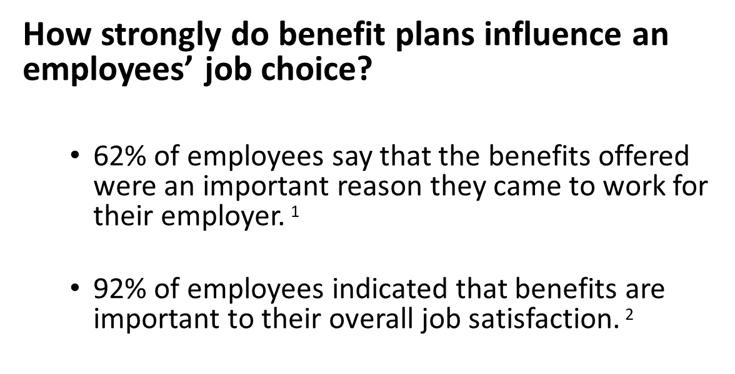
Employee Benefits Are Important
78% percent of workers say their benefits packages are as important as their salaries in keeping them at their current employers. ³
1 MetLife, “Experience a More Human Workplace: MetLife’s 16th Annual U.S. Employee Benefit Trends Study” (2018).
2 Society for Human Resource Management, "Employee Job Satisfaction and Engagement: The Doors of Opportunity are Open” (2017).
3 Randstad US, “Your best employees are leaving, but is it personal or practical?” (2018)

Slide 4
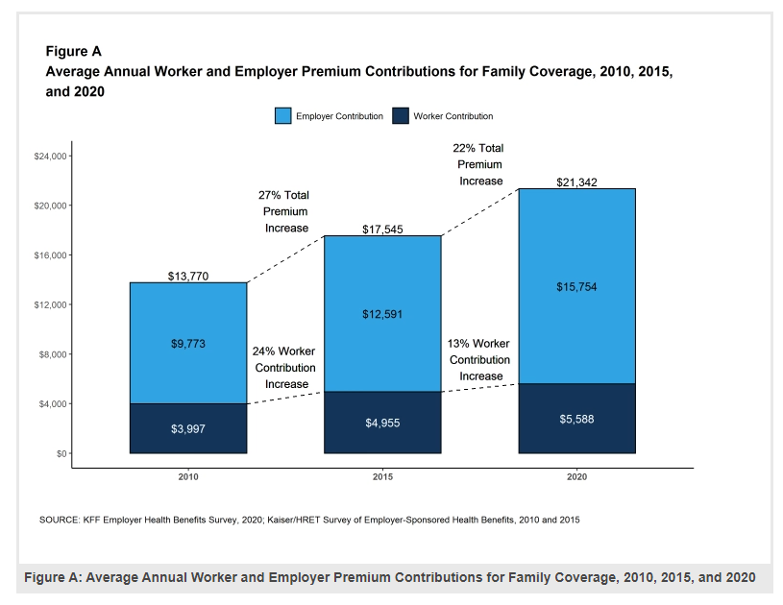
Rising Employee Benefits Costs

Slide 5
What is a Three-to-Five Year Benefits Strategy?
Funding Arrangement
Wellness
Strategic Plan Design
A strategy that works proactively rather than reactively at addressing year-over-year healthcare costs and renewals.
Focus and direction on “where” we want the benefit plan to be.
Allows a company to make targeted and incremental changes over time, that align with cultural and organizational needs.
Requires active management of the healthcare plan, using claims analytics, benchmarking, and strategic consultation.

Slide 6
Employee Benefit Strategies by Employee Size
Health insurance is the largest employee benefit by use, cost, and expectations.
When it comes to a three-to-five year strategy, your approach can vary by the number employees.
Each size segment carries its own challenges and market limitations.
Under 50
51-100
100+
Fully-Insured/ACA
Level-Funded
MEWA Plans
Fully-Insured
Level-Funded
On the Cusp of Partially Self-Funded
Generally, Partially Self-Funded
Fully-Insured
Level-Funded
Regardless of company size, providing a strong and affordable benefits package should be a priority amongst all employers

Slide 7
Funding Arrangement

Slide 8
Funding Arrangement
It is critical for Credit Unions to evaluate the three traditional funding methods for their group benefit plans:
  Fully-Insured
  Level-funded
  Partially self-funded
All three provide different cash flow, risk, and cost benefits.
Which funding arrangement makes sense for each client is specific to their risk preferences, cash flow, and administrative needs.
Funding options vary by client size and market.
Employers can evaluate these funding arrangements for their full suite of benefit plans.

Slide 9
Funding Arrangement: Benefits
Fully-Insured
Predictable, set monthly premiums
Not a long-term contract
Level-Funded
Elimination of some ACA requirements:
Partially Self-Funded
ACA Insurer Fee (3%)
Profit share potential
No additional risk or exposure beyond set premium
Low administrative burden
Community Rating
Less administrative burden than a partially self-funded
  Elimination of some ACA requirements:
    ACA Insurer Fee (3%)
    Community Rating
  Retention of unused claims dollars and reserves
  More control and customization of plan design
  More transparency of costs, commission, and claims
  Larger market with reinsurance carriers

Slide 10
Medical/Rx Funding
Fully Insured Level-Funded Partially Self-Funded
Monthly Liability
$86,221
Monthly Liability
$88,353
Monthly Liability
$90,086
Fixed Cost
$86,221
Fixed Cost
$88,353
Variable Monthly Costs
$66,136
Fixed Monthly Cost paid to Insurer
$23,950
Expected Claims
$52,908
Maximum Claims
$66,136
Administration
Network Access
Actual Claims
ACA Fees
Administration
Network Access
Stop Loss Insurance
Aggregate Insurance
Actual Claims
Administration
Network Access
Stop Loss Insurance
Aggregate Insurance
Actual Claims
Insurer Profits or Loss
Profit / Reserves
Split 50/50 with insurer
Potential Losses
Paid by insurer
Profit / Reserves Potential Losses
Retained by Company
When pricing fully-insured, level-funded, and partially self-funded, costs vary due to the difference in product types.

Slide 11
Funding: Example
Scenario: Large employer (100+ employees) that had a fully-insured health plan.
Recommendation: After a thorough evaluation of their cash flow needs, continued rising healthcare costs, and desire for transparency into their health plan, we made the recommendation to transition to a partially self-funded health plan.
Outcome:
  Subsequent claims and renewal illustrations have shown significant savings in actual spend verses their anticipated premiums, had the Company remained fully-insured.
  More control over plan design at renewal.
  Ability to shop the reinsurance market annually to offer more competitive options for the Company at renewal.
  Stabilized plan spend, which allowed minimal employee cost increases and plan design changes at subsequent renewals.

Slide 12
Funding: Example

Slide 13
Strategic Plan Design

Slide 14
Strategic Plan Design
It is important for Credit Unions to not only offer benefit plans that are in line with benchmark, but that also allow for member consumerism and choice.
For large Credit Unions, analysis of their actual claims allows them to create a customized benefits plan that focuses on their own specific cost drivers and areas of utilization.
Offerings
Benefits
Network
Dual or Triple Option
Core and Buy Up model
HDHP with HSA
  Employer-funded HSA dollars
Deductible
Site of care steerage
Strategic Rx copay structure
Health Reimbursement Arrangement (HRA)
Formulary
Open Access Plans
Narrow Networks
  Accountable Care Organizations (ACO)
  HMO
  Gatekeeper
Dual or single network offering

Slide 15
Strategic Plan Design: Example
Scenario: Large employer (450+ employees) that only offered one traditional health plan with a $1,250 deductible. Employees paid $85/month for single coverage. We saw significant claims spend increasing year-over-year. Based on our annual claims review, we found outpatient, PCP office visits, and brand-named drugs to be three specific high areas of spend.
Recommendation:
  We rolled out a triple plan option, which included their current plan as a “Buy Up”, a “Mid” plan that was also a traditional health plan with a higher deductible, and we offered a third HDHP with employer-funded HSA.
  We added strategic benefits to encourage consumerism, such as $5 copay for Teladoc, $150 copay for free standing outpatient, and $3 generic copays
  The HDHP was offered at $0 for single coverage
Outcome:
  Through proper education and rollout, we had more than 40% of the employees move to the new HDHP and another 35% move to the mid plan in year one. We had very positive employee feedback on the options and choices.
  In year two, more than 50% enrolled in the HDHP plan.
  Offering the triple plan structure allowed us to better optimize the Company’s premium dollars (passing premium savings back on as an employer-funded HSA contribution) and give the employees more choice and options on their own premium/cost share.
  The penetration into the HDHP showed a significant company per employee per month claims savings over the subsequent rolling 12-month period.
  Increased employee satisfaction with the benefit plans and choices they were offered.

Slide 16
Strategic Plan Design: Example
 | High Deductible Health Plan | Mid Plan | Buy-Up Plan
Network PCP Visits | deductible then 0% | $30 copay | $30 copay
Teladoc | $59 towards deductible | $5 copay | $5 copay
Network Specialist | deductible then 0% | $60 copay | $60 copay
Network Urgent Care | deductible then 0% | $75 copay | $75 copay
Emergency Room | deductible then 0% | $350 copay, then 0% | $350 copay, then 0%
Deductible (ind/fam)
In-Network | $5,000 / $10,000 | $3,500 / $10,500 | $1,250 / $3,750
Out-of-Network | $15,000 / $30,000 | $10,500 / $31,500 | $4,500 / $13,500
Coinsurance
In-Network | 100% / 0% | 100% / 0% | 100% / 0%
Out-of-Network | 50% / 50% | 50% / 50% | 50% / 50%
Out-of-Pocket (ind/fam)*
Network | $5,000 / $10,000 | $7,900 / $15,800 | $7,900 / $15,800
Non-Network | $20,700 / $41,400 | $23,700 / $47,400 | $23,700 / $47,400
Network Outpatient | deductible then 0% | $150 copay (free standing facility) then 0%; deductible then 0% for hospital setting | $150 copay (free standing facility) then 0%; deductible then 0% for hospital setting
Network Inpatient | deductible then 0% | deductible, then 00% | deductible then 0%
Prescription Drugs Retail (30 day) Tier 1/2/3/4 | deductible | $3/$45/$90/25% to $450 | $3/$45/$90/25% to $450

Slide 17
Wellness

Slide 18
Wellness
During a Credit Union’s benefit review process, Employers should focus on potential high-cost and high-exposure areas of spend.
  Generally, looking at targetable and steerable cost-drivers
  Keeping healthy members healthy and engaged
By analyzing data related to preventive care utilization, chronic conditions, and other lifestyle conditions, a customized wellness program can be built.
A wellness program should address that Employer’s specific needs, including components such as:
  Turnkey wellness Vendors
  Wellness events, such as biometric screenings, flu shot clinics, and wellness fairs
  Plan design that focuses on lifestyle conditions
  Rewards and incentives to drive health-oriented behaviors
  Effective employee education and campaigns

Slide 19
Wellness: Example
Scenario: Large manufacturing employer (600+ employees) had significant prevalence of diabetes, hypertension, and chronic conditions with low medication compliance. Several high-cost claimants were related to stroke and heart attack. Employee demographic was low income, and we had concerns about employees being able to afford and access their needed medications.
Recommendation:
  Added an HDHP-compatible Preventive Rx Rider for low-cost and generic maintenance medications for conditions such as diabetes, asthma, hypertension, cholesterol, etc.
  Members using in-network pharmacies could obtain any medication on this list at a $0 cost share, which included diabetic insulin.
Outcome:
  Medication adherence and compliance more than doubled in the subsequent 12 month claims period.
  Saw an increase in generic utilization versus brand drugs due to offering the $0 copay, which helped stabilize overall Rx spend
  Decrease in lifestyle-related High-Cost Claimants.
  Increased employee satisfaction by having access to these no-cost medications.

Slide 20
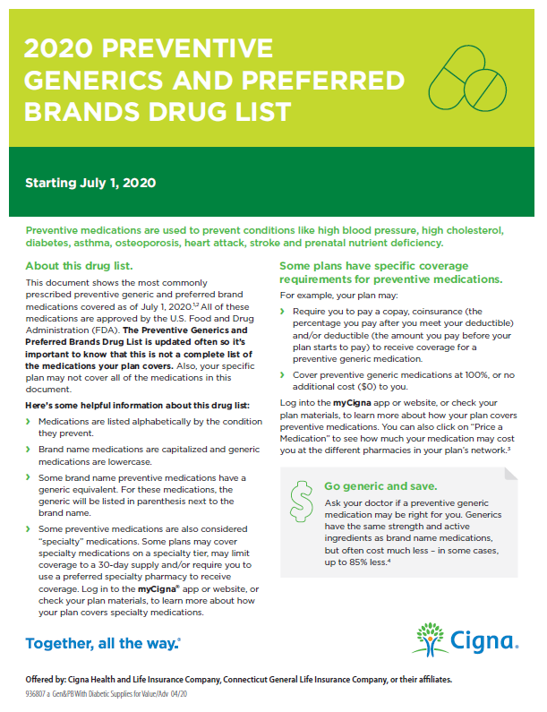
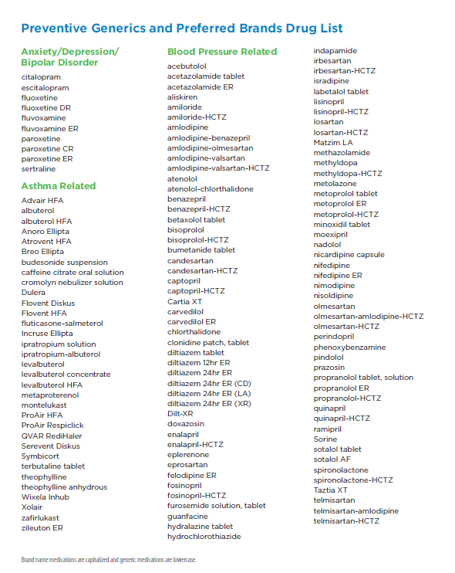
Wellness: Example
Most carriers, TPAs, and PBMs provide Preventive Rx Rider Options
ACA and HDHP Compatible
$0 cost maintenance medications for chronic conditions such as:
  Asthma
  Diabetes
  Hypertension
  Anxiety and Depression
  And many more lifestyle related conditions

Slide 21
Summary
While each Credit Union has varying financial and cultural needs, we find a common goal of offering the best benefits possible at the lowest cost available to the Credit Union and employees
By proactively creating a three-to-five year benefit strategy that includes funding, plan design, and wellness, we have been successful in creating long-term strategies with Credit Unions to help stabilize their ever-increasing healthcare costs.

